Slide 1

CREDIT SCORE PREDICTION
DMA PROJECT
BY NERAV RANGARI

Slide 2
Data Set Description

Slide 3
The dataset represents financial and behavioral data for customers over multiple months. It contains detailed information about customer demographics, financial standing, loan characteristics, and credit behavior.
Key Attributes:
Customer Demographics: customer_id, name, age, occupation, ssn.
Financial Details: annual_income, monthly_inhand_salary, outstanding_debt, credit_utilization_ratio, credit_history_age.
Loan Details: type_of_loan, num_of_loan, total_emi_per_month, interest_rate.
Behavioral Indicators: delay_from_due_date, num_of_delayed_payment, payment_behaviour, credit_mix.
Derived Features: credit_score, payment_of_min_amount, monthly_balance

Slide 4
Potential Outcomes from Analysis
Credit Risk Assessment: Identify high-risk customers based on loan delays, outstanding debt, and credit utilization ratio.
Segmentation: Group customers by financial behavior, loan types, or credit scores.
Predictive Analytics: Build a credit score prediction model or identify factors impacting the credit score.
Behavior Analysis: Explore patterns in payment behavior and how they influence financial health.

Slide 5
Initial Data Quality, Integrity, and Ethics Issues
Data Quality:
- Missing or incomplete data
- Inconsistent formats
- Type_of_loan is stored as a list
Data Integrity:
- Duplicate records or mismatched customer IDs.
- Outliers, such as extremely high or low credit scores or incomes.
Data Ethics:
- Personally identifiable information (PII) such as name and SSN raising privacy concerns.
- Customer consent
- Using insights to push high-risk loans or is unethical.

Slide 6
Data Preparation / Data Wrangling

Slide 7
DATA PROFILING
Data Type: Identifies the type of data (e.g., integer, float, string, date).
Missing Values: Number and percentage of missing values for each column.
Unique Values: Number of distinct values in each column.
Value Distribution: Summary statistics (mean, median, mode, min, max) for numerical columns.
Outliers: Identifying outliers that might skew analysis or modeling.
Data Quality Issues: Identification of errors, inconsistencies, or invalid data entries.

Slide 8
Column Name | Data Type | Non-Null Count | Description
id | Object | 100,000 | Unique identifier for records.
customer_id | Object | 100,000 | Unique customer identifier.
month | Object | 100,000 | Month associated with the record.
name | Object | 100,000 | Customer name.
age | Int64 | 100,000 | Customer's age (filled missing values).
ssn | Object | 100,000 | Social Security Number.
occupation | Object | 100,000 | Customer occupation (filled missing).
annual_income | Float64 | 100,000 | Annual income (mean imputation used).
monthly_inhand_salary | Float64 | 100,000 | Monthly salary after deductions.
total_emi_per_month | Float64 | 100,000 | Monthly EMI payments.
num_bank_accounts | Int64 | 100,000 | Number of active bank accounts.
num_credit_card | Int64 | 100,000 | Number of credit cards.
interest_rate | Int64 | 100,000 | Interest rate on loans.
num_of_loan | Int64 | 100,000 | Number of loans.
type_of_loan | Object | 100,000 | Type of loans availed.
delay_from_due_date | Int64 | 100,000 | Days of delay in payment.
num_of_delayed_payment | Int64 | 100,000 | Number of delayed payments.
changed_credit_limit | Float64 | 100,000 | Adjustments to credit limits.
num_credit_inquiries | Int64 | 100,000 | Number of credit inquiries.
credit_mix | Object | 100,000 | Types of credit accounts.
outstanding_debt | Float64 | 100,000 | Amount of outstanding debt.
credit_utilization_ratio | Float64 | 100,000 | Ratio of credit utilization.
credit_history_age | Int64 | 100,000 | Age of credit history in years.
payment_of_min_amount | Object | 100,000 | Payment of minimum amount ('Yes'/'No').
amount_invested_monthly | Float64 | 100,000 | Monthly investments made.
payment_behaviour | Object | 100,000 | Payment behavior description.
monthly_balance | Float64 | 100,000 | Monthly balance after all deductions.
credit_score | Int64 | 100,000 | Credit score (integer between 0–2).
credit_score_category | Object | 100,000 | Credit score grouped into categories.

Slide 9
Dataset Overview:
The dataset has 100,000 rows and 28 columns, with 18 numeric columns and 10 categorical columns.
Missing Values: Handling missing data was done using the median (for numeric) and mode (for categorical) as appropriate.
Correlation Matrix:annual_income and monthly_inhand_salary (0.998), credit_score is negatively correlated with num_credit_card and num_bank_accounts, but positively correlated with monthly_balance.
Outliers: Outliers were handled using the IQR method, and the counts of outliers were stored but capped to the upper and lower bounds.
Categorization: The credit_score was categorized into three groups: 'Poor', 'Average', and 'Good'.
Group Analysis: Average annual income grouped by occupation was computed.
Merging: Additional data merged using the customer_id

Slide 10
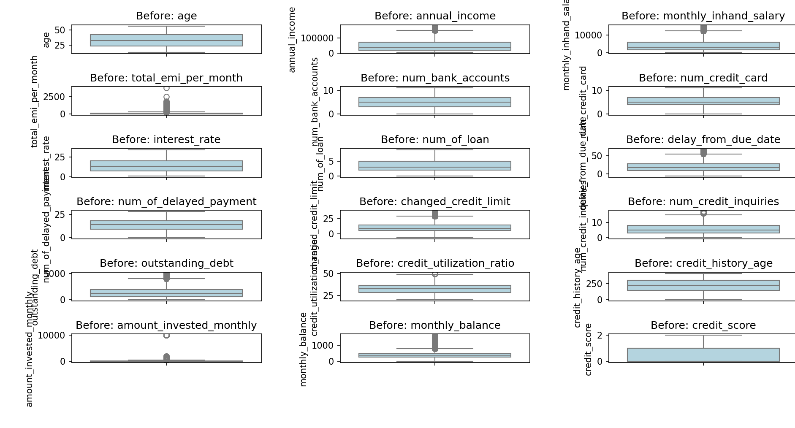
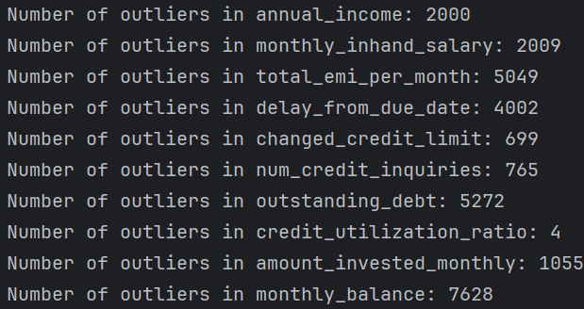
BEFORE REMOVING THE OUTLIERS

Slide 11
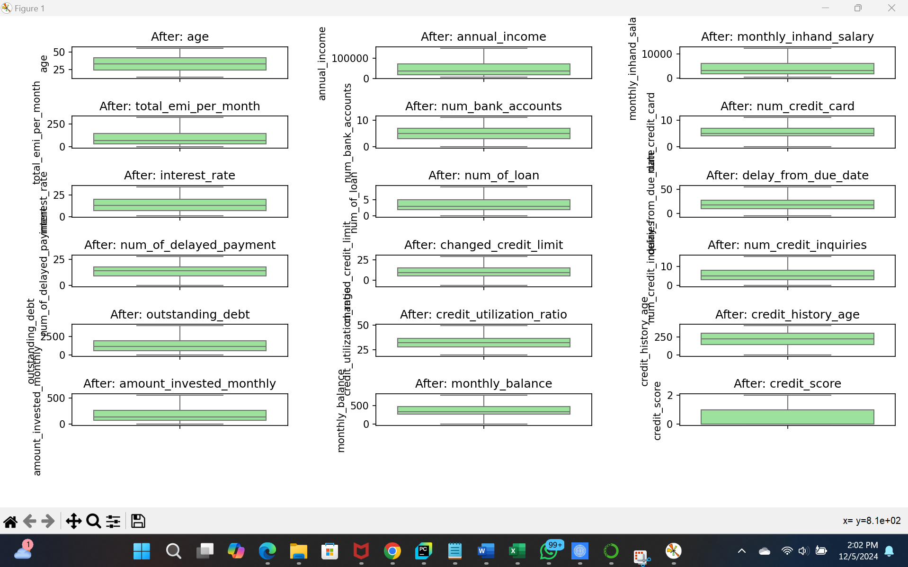
AFTER REMOVING THE OUTLIERS

Slide 12
Data MINING

Slide 13
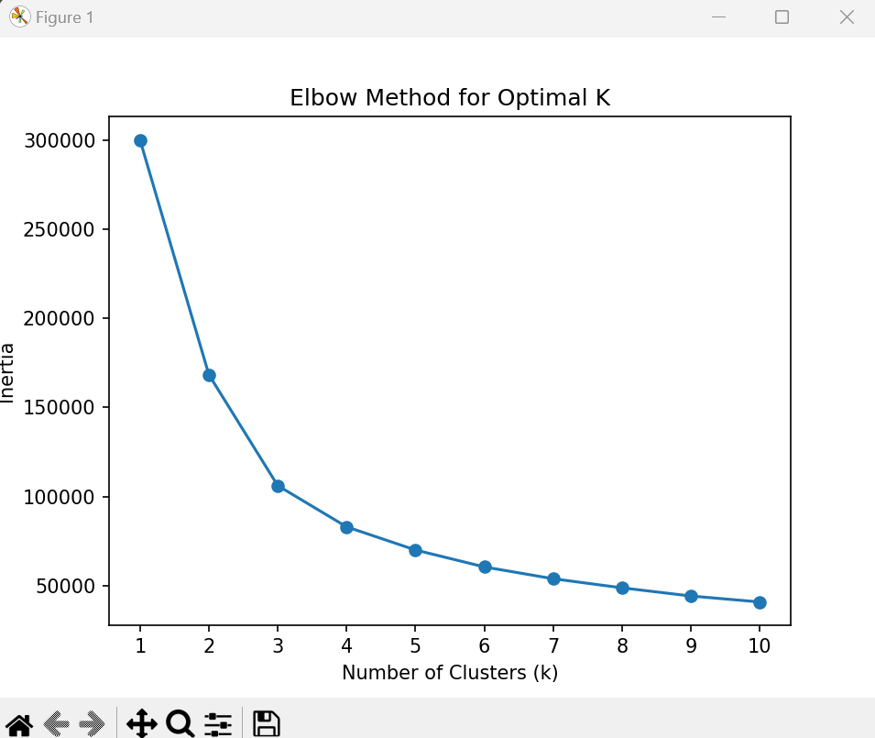
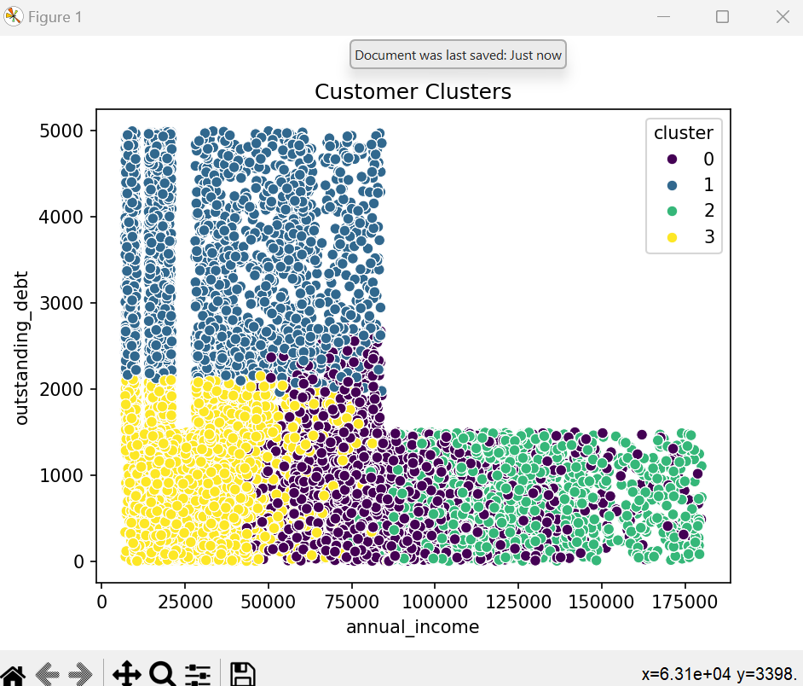
CLUSTER ANALYSIS: K MEANS

Slide 14
Cluster centers [[-0.61646275 -0.42866006 -0.45725427] [ 1.68869856 -0.60067677 1.88676678] [-0.50570696 1.55044209 -0.64676044] [ 0.64791762 -0.40825485 0.30906192]]
Identified 4 customer groups based on their income, debt, and balance. This segmentation is useful for understanding different customer profiles, which can help target them with tailored financial products or strategies.
Cluster 1 could be targeted for premium financial services.
Cluster 2 may require debt restructuring or financial advice.
Cluster 3 might represent high-net-worth individuals who need high-end financial products.
Cluster 4 could be customers with minimal financial activity who may benefit from financial education or incentives for higher engagement

Slide 15
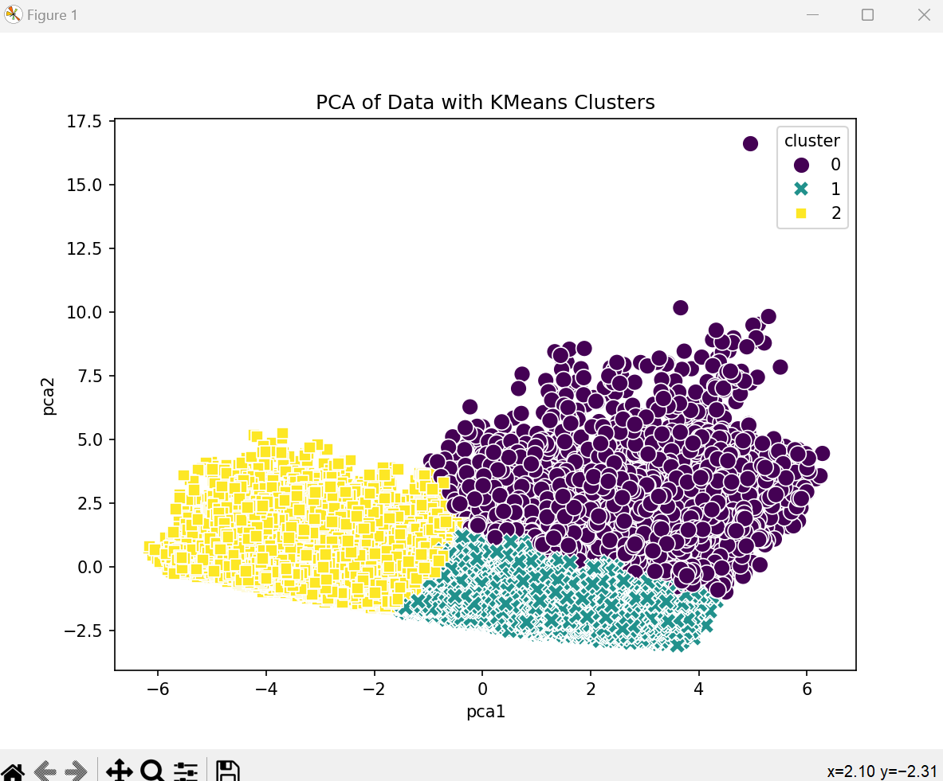
Dimensionality Reduction
Cluster Sizes:
Cluster 1: 44,430 samples
Cluster 2: 34,040 samples
Cluster 0: 21,530 samples
Cluster 0 might represent customers who are struggling with debt or have a higher financial burden (more loans and outstanding debt).
Cluster 1 likely represents a typical, average group with stable financial behaviors.
Cluster 2 may represent wealthier or more financially active customers with higher engagement in investments and credit management.

Slide 16
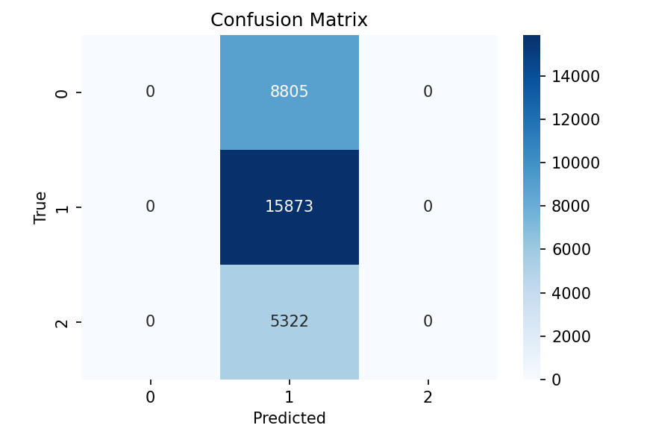
CLASSIFICATION: LOGISTIC REGRESSION

Slide 17
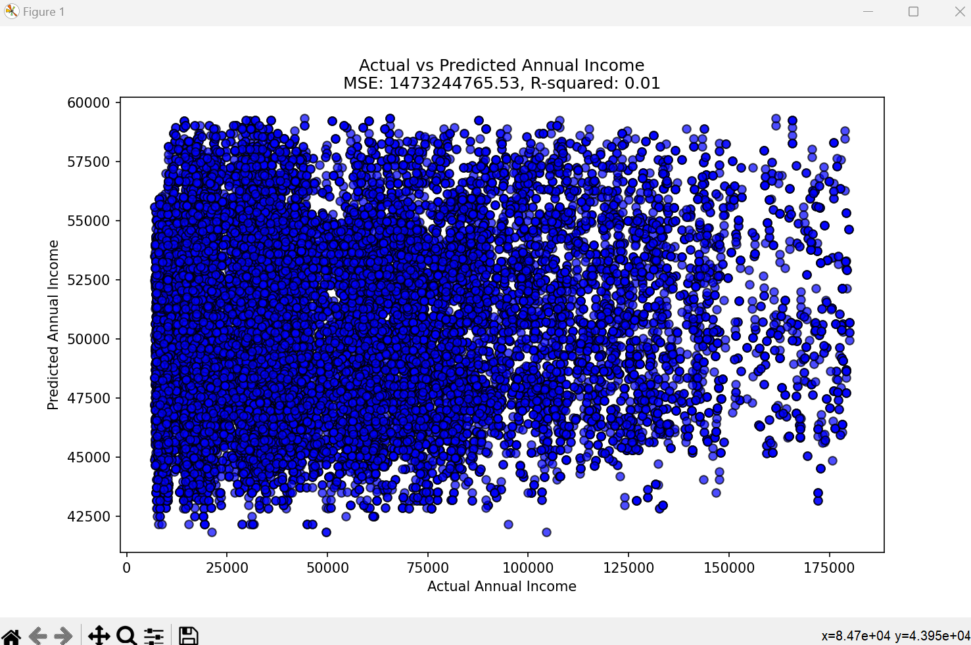
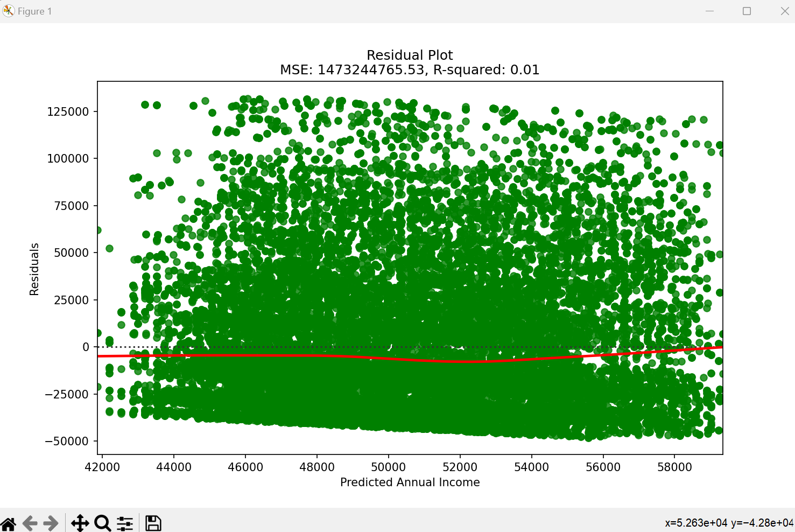
REGRESSION: LINEAR REGRESSION

Slide 18
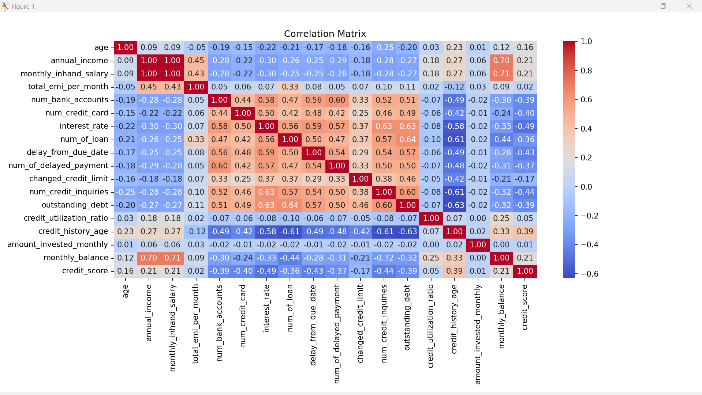
Correlation Matrix

Slide 19
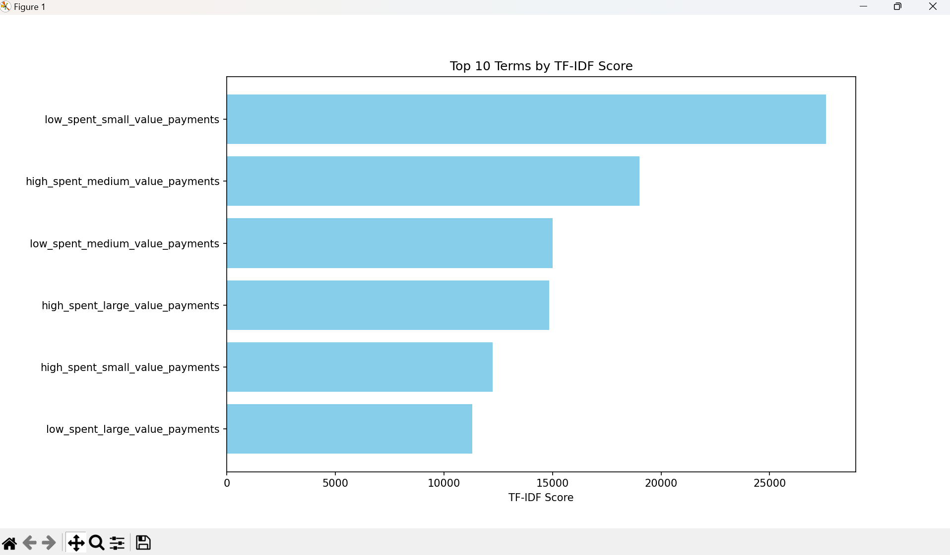
TEXT MINING

Slide 20
Data VISUALIZATION

Slide 21
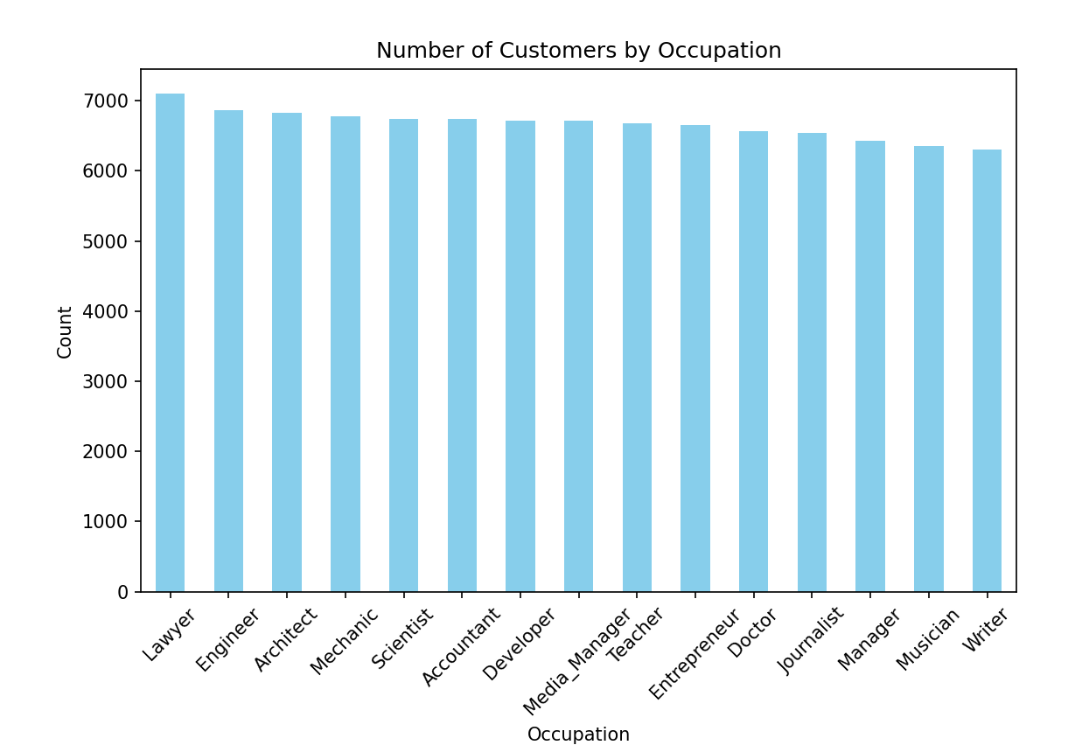
Column Chart

Slide 22
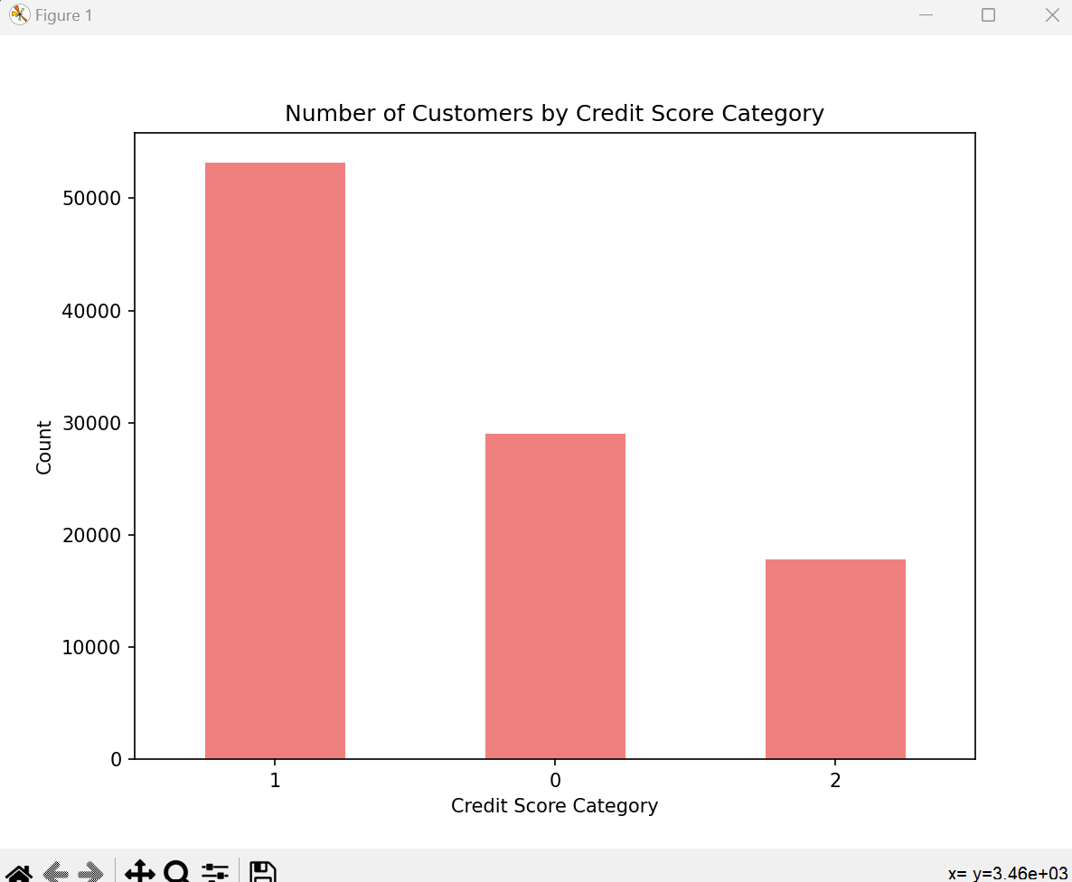
Bar Chart

Slide 23
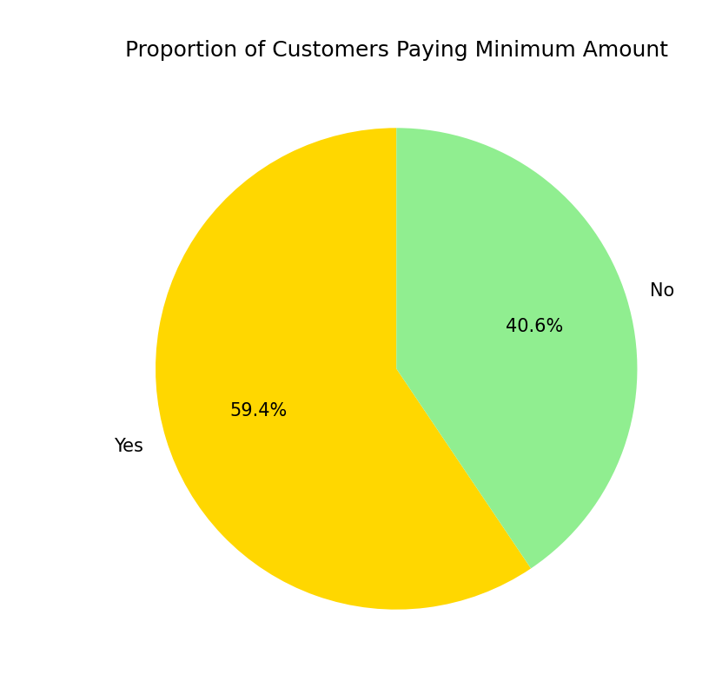
Pie Chart

Slide 24
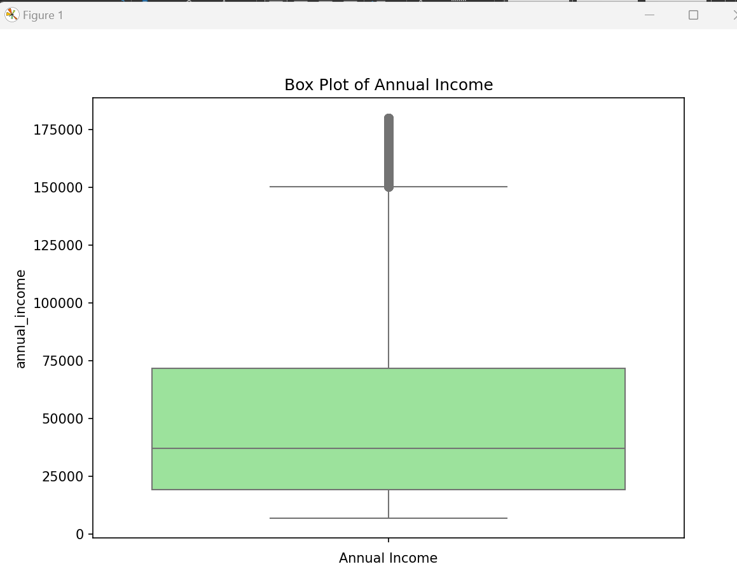
Box Plot

Slide 25
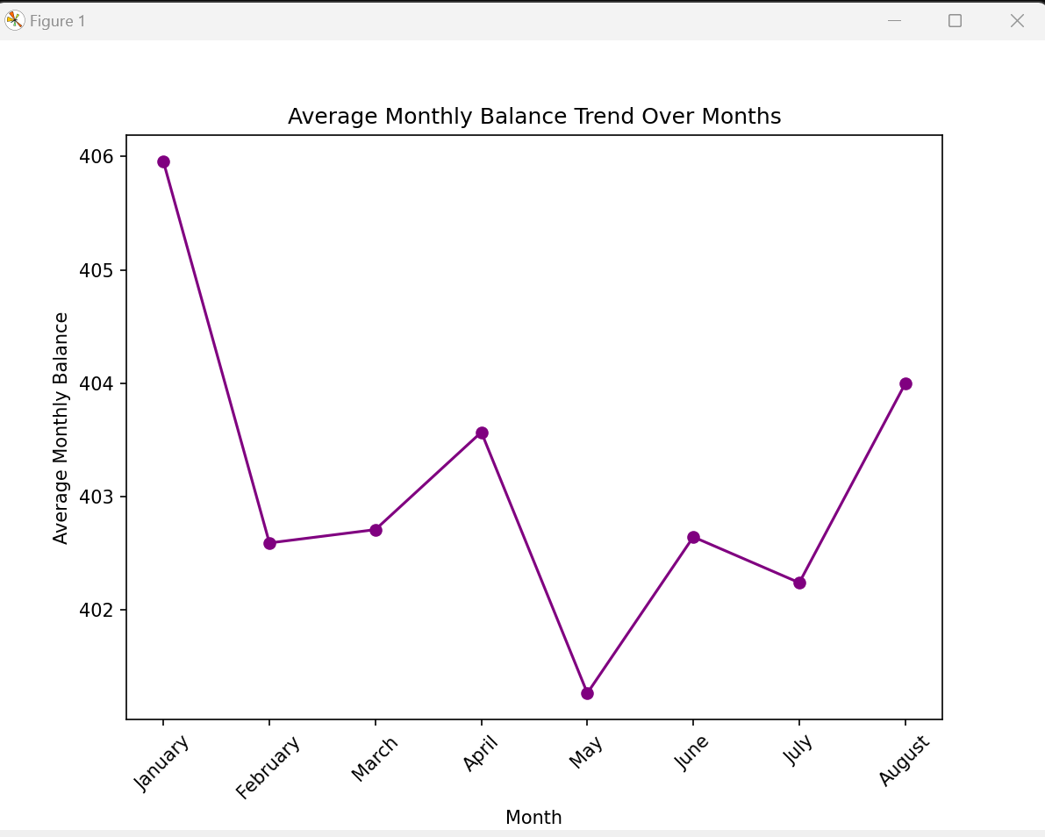
Line Plot

Slide 26
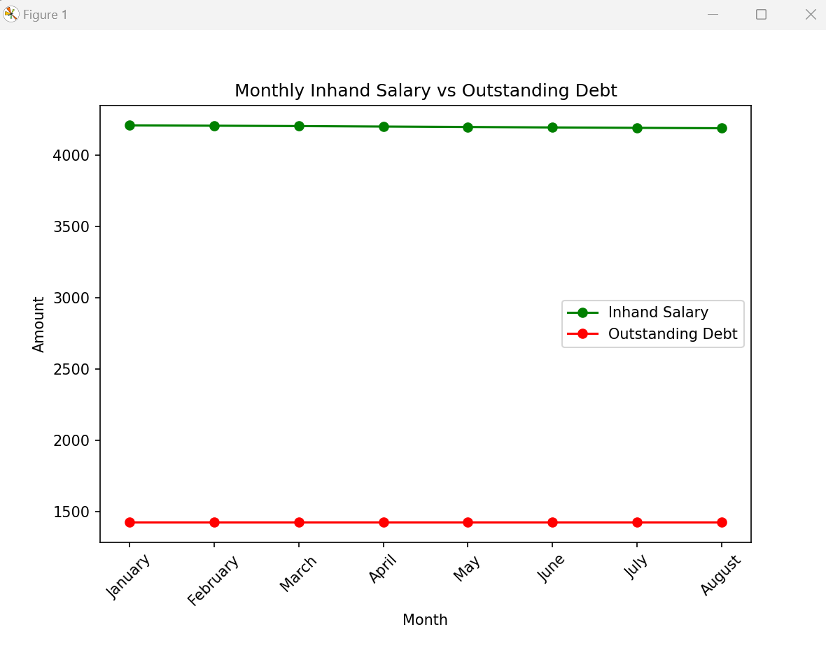
Multi-Line Plot

Slide 27
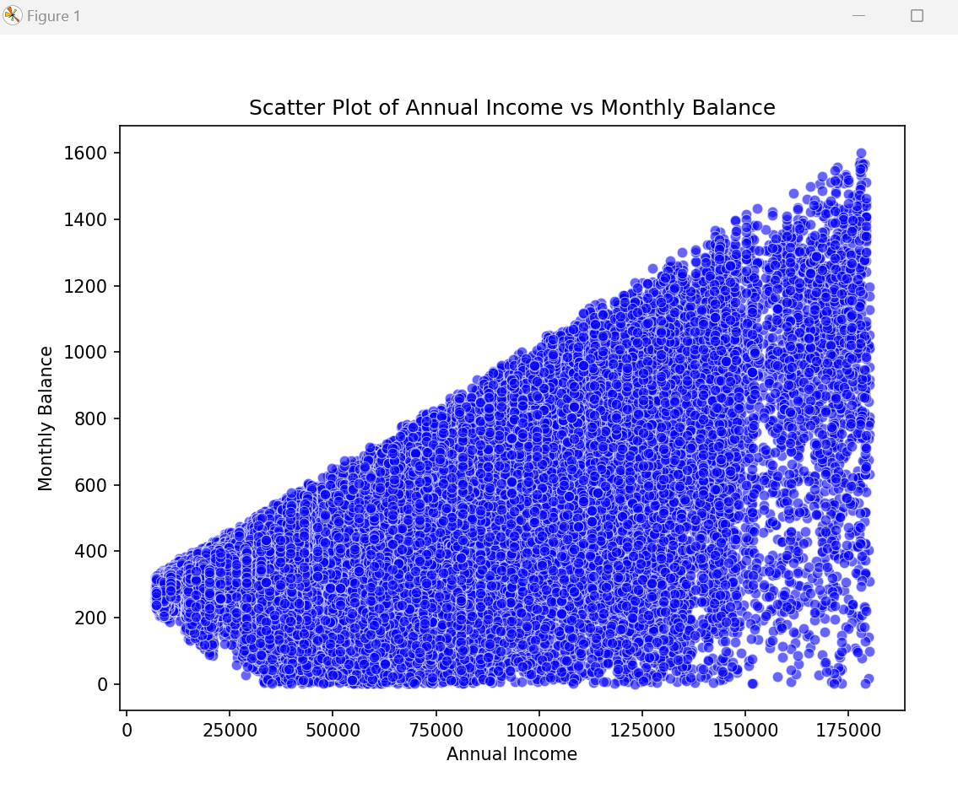
Scatter Plot

Slide 28
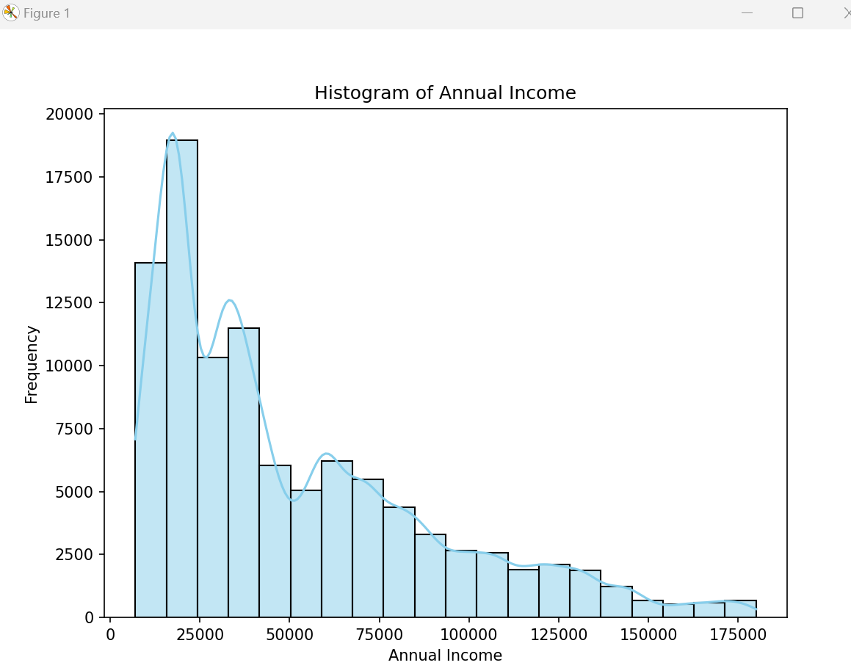
HISTOGRAM

Slide 29
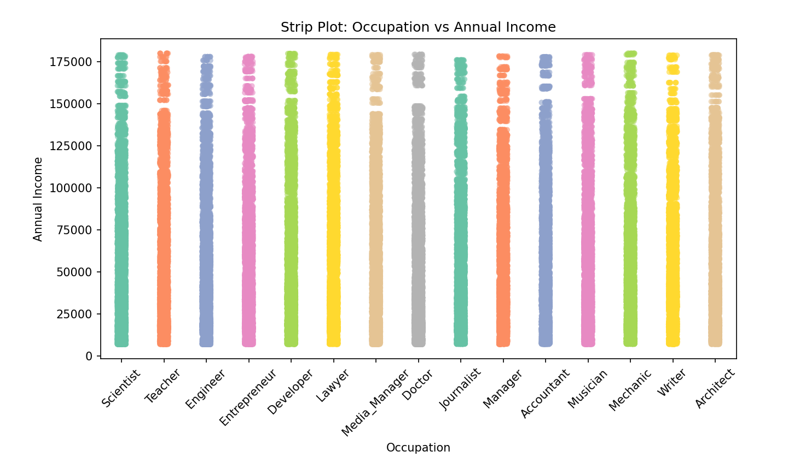
Strip Plot

Slide 30
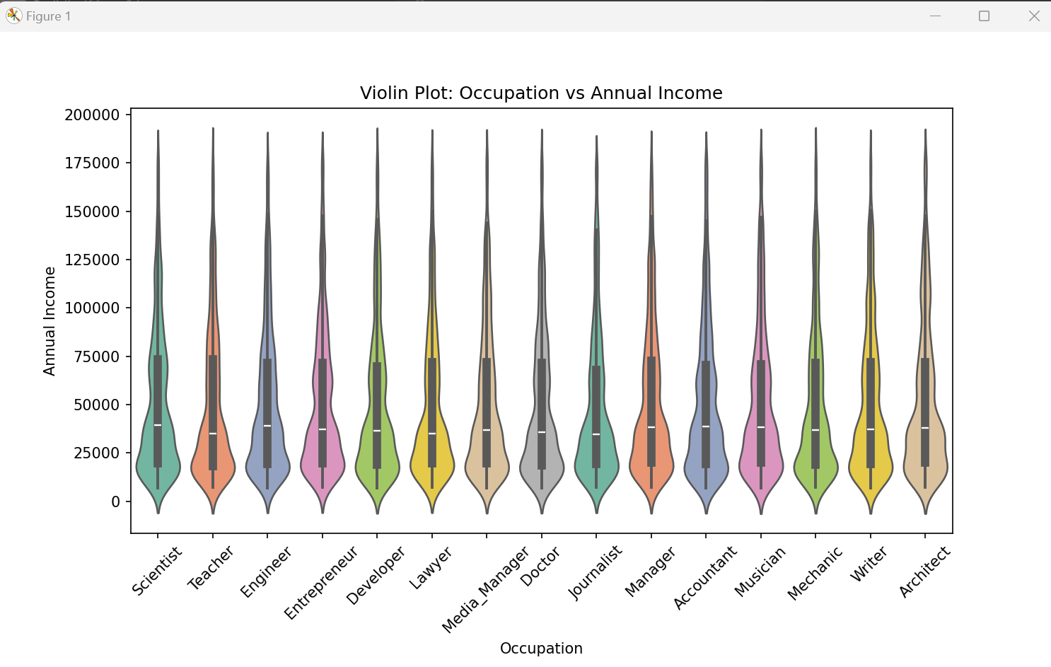
Violin Plot

Slide 31
CONCLUSION
The best performing model for the credit score data is K means, the output segments customers based on income, debt, and balance, allowing businesses to tailor marketing, product offerings, and support to each group. This helps create personalized strategies, such as targeting high-income customers with wealth management or offering debt consolidation to those with financial challenges. Further we can do customer profiling comparing the behavior and features of customers within each cluster, such as average credit score, debt, or monthly balance.

Slide 32
THANK YOU

